Slide 1
Data Demolishers
Michael Cipriani
Laura Kemp
Sam Pierce

Slide 2


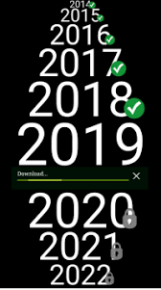

Core Message
Looking at popular music trends over the last five years

Slide 3


Data Sources
Spotify API
Billboards Hot 100 List
Billboards Module
Spotipy Module
Notes:
Spotify is a digital music, podcast, and video service that gives you access to millions of songs and other content from creators all over the world.
Billboard builds lists on physical and digital purchases, streaming, and radio airplay (Neilson)

Slide 4
Questions
Is there a correlation between audio features?
Is there a major difference in audio features over the last five years?
Are there any major differences or commonalities in audio features between years?
What are the most popular artists & songs?
Notes:
Exploratory analysis

Slide 5
Data Exploration & Cleanup Process
Scrape the billboard charts
Match artist names on billboard chart & Spotify
Collect Spotify audio features
Format DataFrame

Slide 6
Audio Feature Definitions
Danceability- describes how suitable a track is for dancing
Energy- is a measure of intensity and activity
Acousticness- lack of electrical amplification
Instrumentalness- predicts whether a track contains no vocals
Liveness- detects the presence of an audience
Valence- a measure describing the mood
Notes:
Danceability, Energy, Acousticness, Instrumentalness, Liveness, & Valence, on a 0 to 1 scale
Tempo & Duration, not on 0 to 1 scale

Slide 7
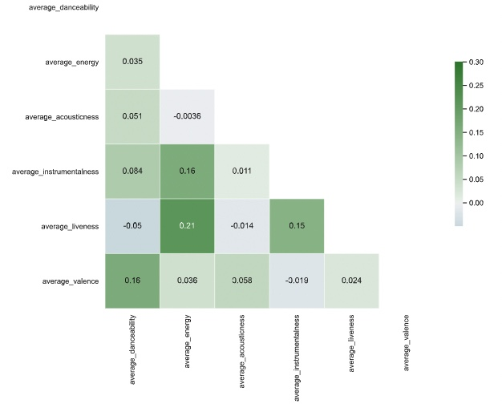
Correlations
Correlation Between
Song Features

Slide 8
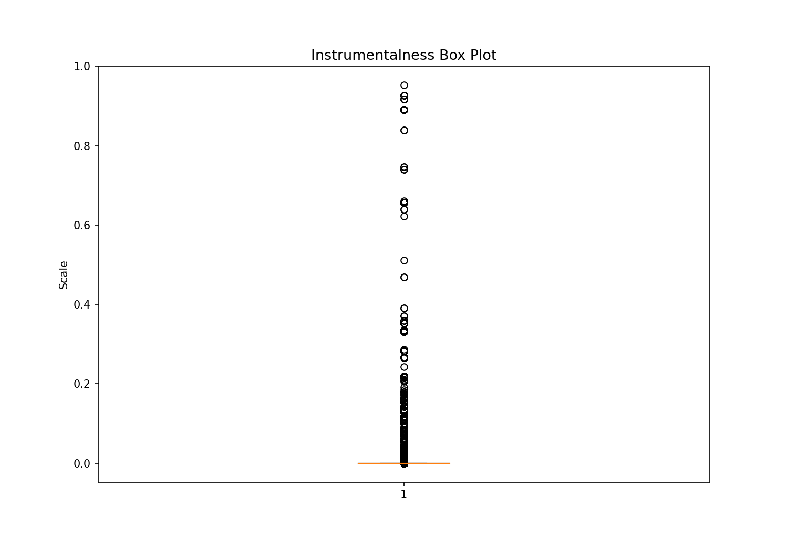
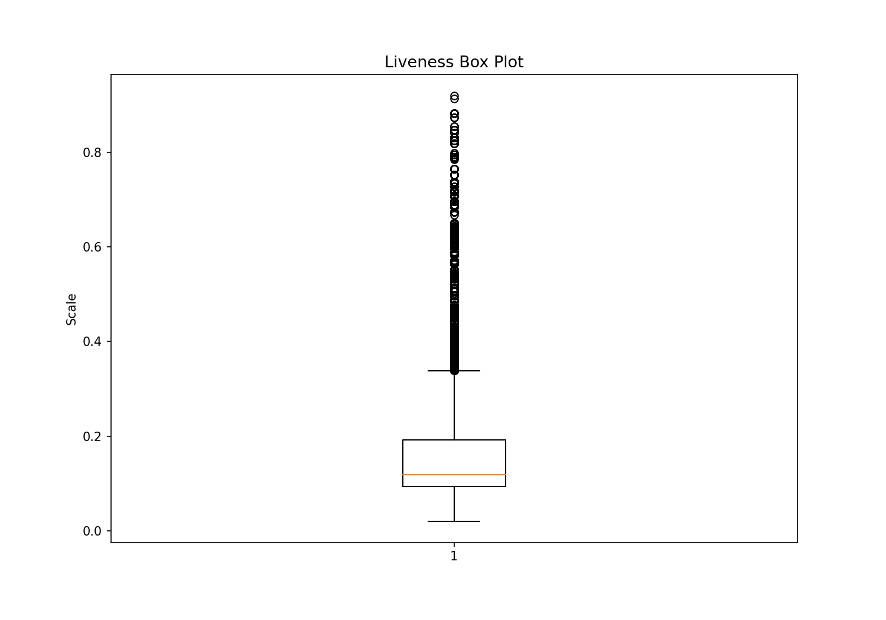
Box Plots

Slide 9
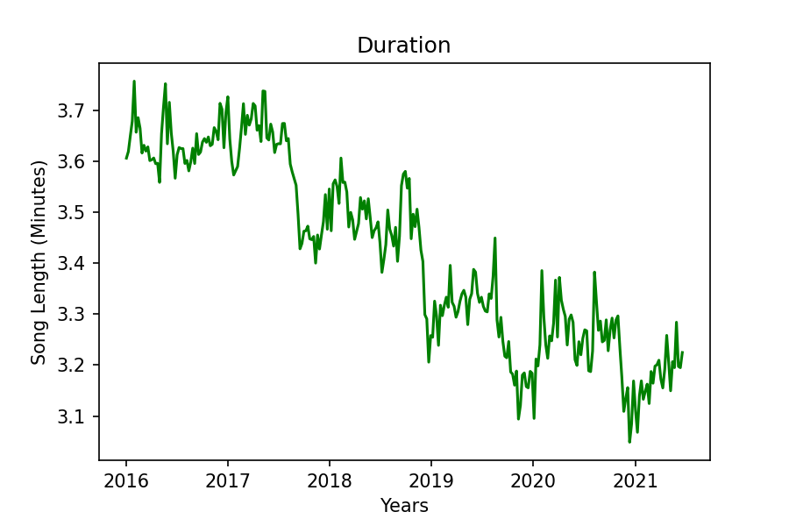
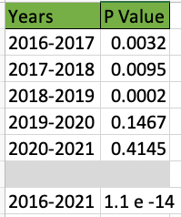
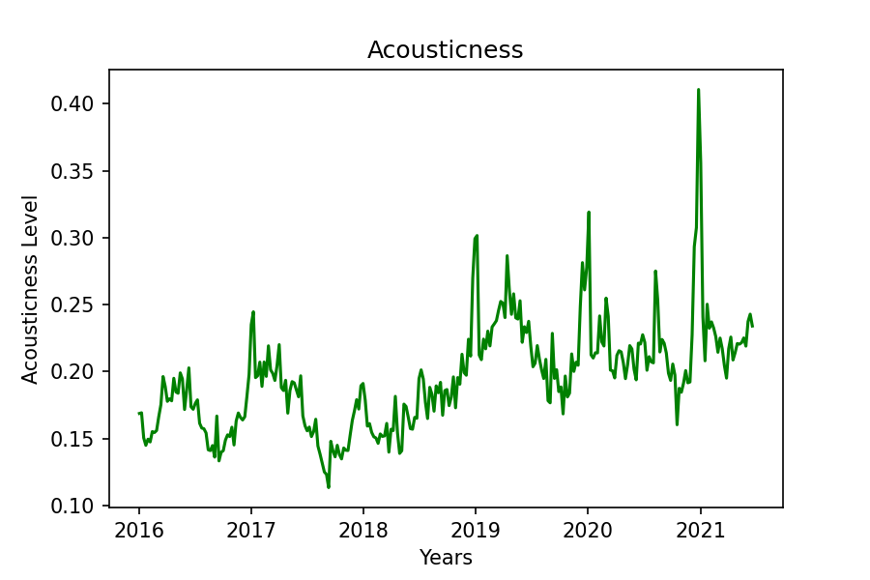
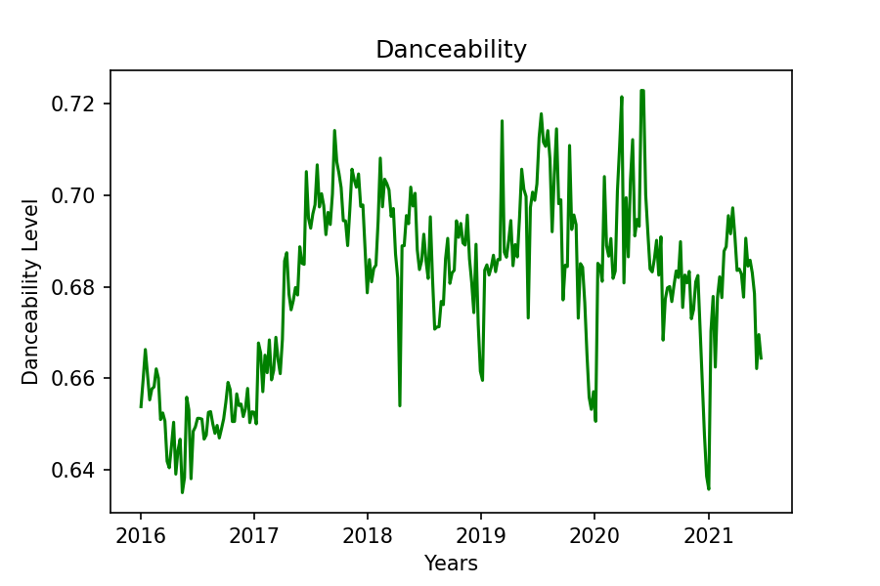
Differences Over the last 5 Years
Notes:
COVID

Slide 10
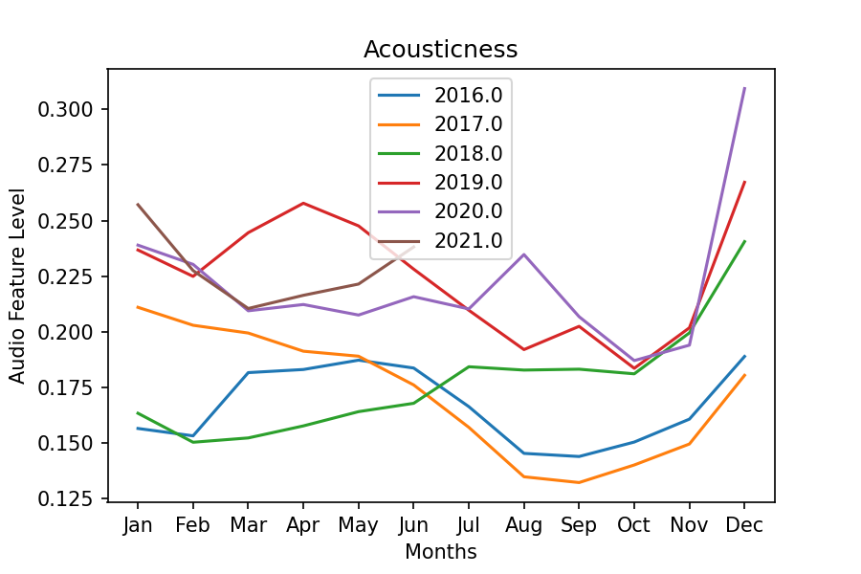
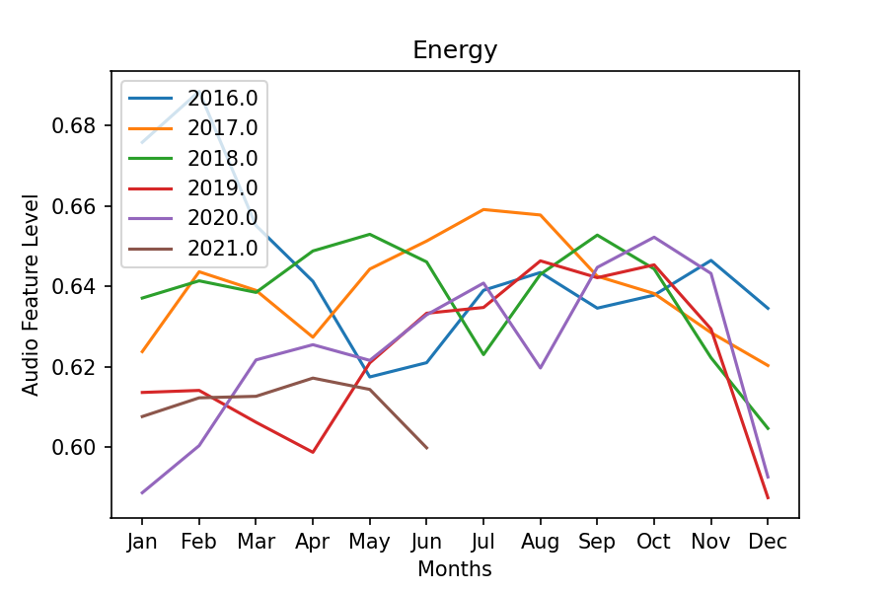
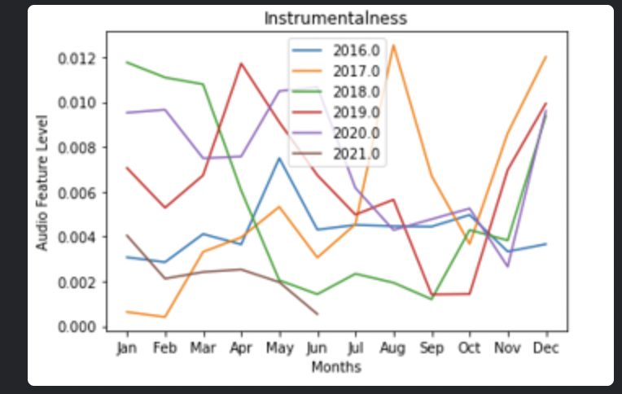
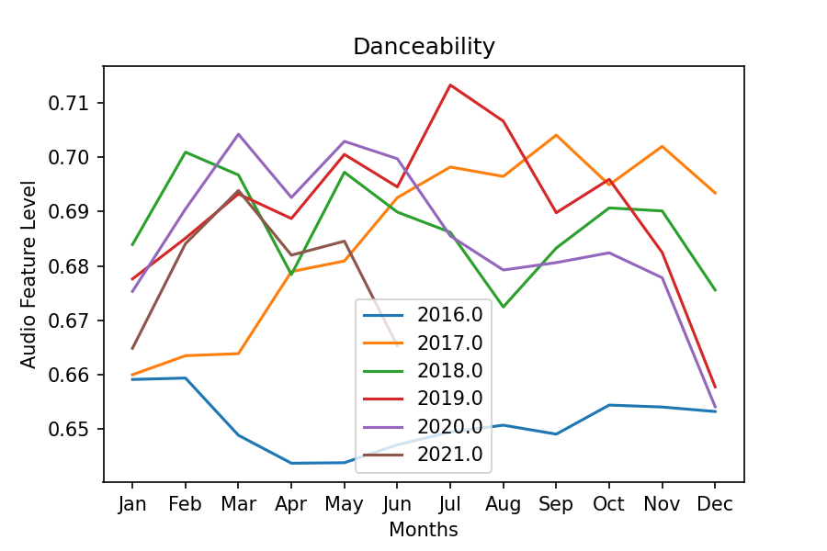
Difference or commonalities between years
Spike or Slump in December
P Value= 3.3 e -5
P Value = 0.0013
P Value= 0.0486
P Value= 0.0865
Notes:
Christmas Music- noticeable drops in danceability and energy
increases in acousticness & instrumentalness in December, more than any other month

Slide 11
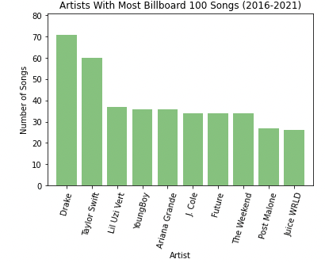
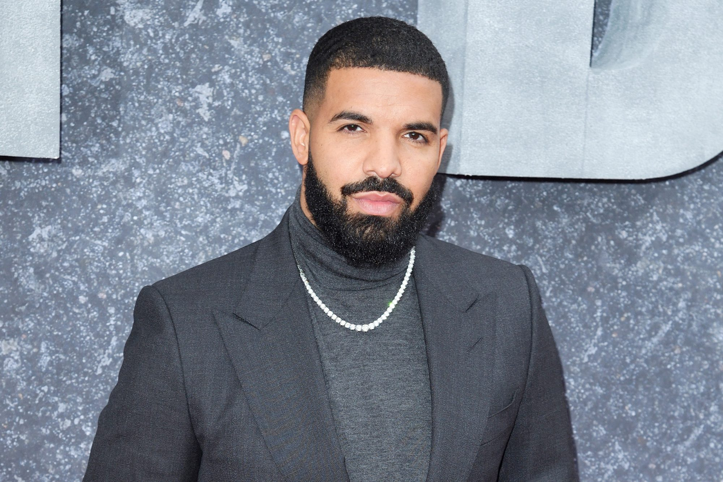
Top Artists
z

Slide 12


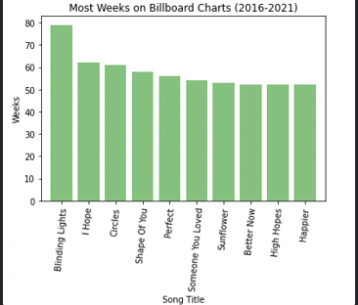
Top Songs

Slide 13
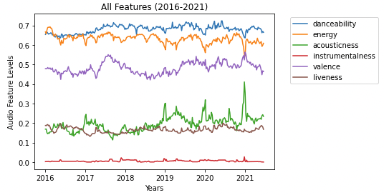
Notes:
Overall view of the features, you can see how features vary by year

Slide 14
Summary of Conclusions
There is no significant correlation between audio features
The duration of songs has gradually decreased in the past five years
Drake and Blinding Lights are the most popular artist and song over the past 5 years
SAD may influence music characteristics in December??

Slide 15
Limitations
Only looking at 5 years of data
Limited to results of the Hot 100
Current knowledge of data analytics
Notes:
The Hot 100 is only looking at the United States data

Slide 16

Questions

Slide 17
References
https://developer.spotify.com/documentation/web-api/reference/#endpoint-get-audio-features
https://github.com/guoguo12/billboard-charts
https://spotipy.readthedocs.io/en/2.18.0/#

